Slide 1
Zowe Project Overview

Slide 2
Agenda
Introducing Zowe
Quick Facts about Zowe
Why Zowe?
Zowe Vision Statement
What’s in Zowe?
Zowe REST Services
Zowe Web Desktop
Zowe CLI
Zowe API Mediation Layer
Getting Started with Zowe
“Demo”

Slide 3

Introducing Zowe
An extensible framework for connecting applications and tools to mainframe data and applications.
Aims to make the mainframe an integrated and agile platform within the changing IT architectural landscape.
First open source project on z/OS. All code is licensed under the Eclipse Public License version 2.0

Slide 4



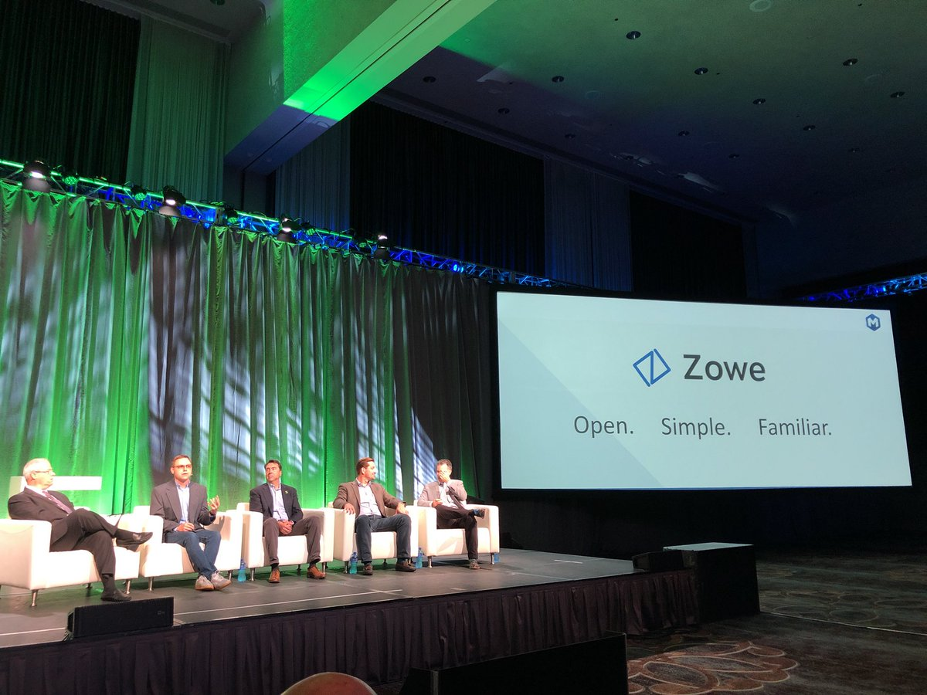
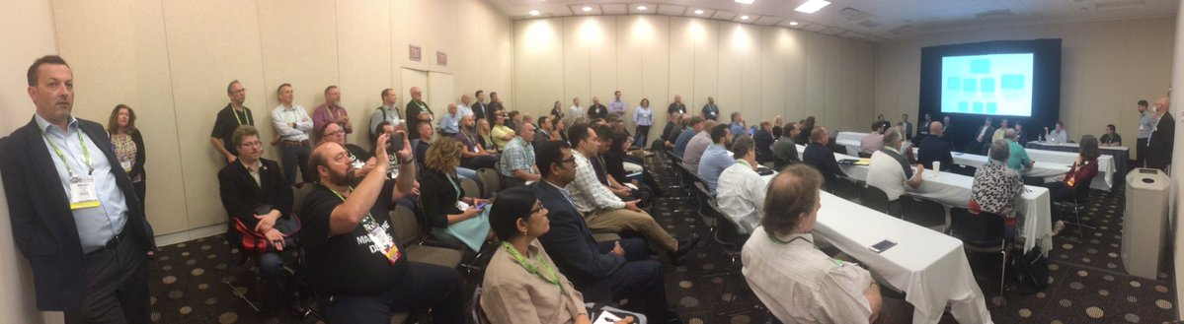
Quick Facts about Zowe
Zowe 1.0.0 Announce at THINK SF 2019
100% Open Source (EPL 2.0)
Defined extensions points
Framework ready for commercial exploitation
Pronounced as “Zoe” – [zoh-ee] in English
Not an acronym – just a simple, fun and easy name
Using the spelling “Zowe” allowed us to trademark
An open source project under the Open Mainframe Project (OMP), a collaborative project within the Linux Foundation
IBM, Rocket Software and CA Technologies are founding members
Generally Available on Feb 8th, 2019

Slide 5



Why Zowe ?
Information Technology is undergoing a revolution of changing architectures
Co-Existence With Other Cloud Models
Protecting Current and Future Investments
Simple and Familiar
Notes:
What is happening in market that is bringing us together and our vision of the best industry approach for the future of the MF
Co-existence with other cloud deployment models
Protecting future investments
Make it simple and familiar
What is the take-away from this slide?
The Zowe project has a clear vision of the most critical challenges facing the Mainframe ecosystem given the shifting IT architectural landscape

Slide 6
Zowe Vision Statement
Attract new people
Demystify the Z platform
Enhance integration and consumability
Promote Open community of practice
Reduce learning curve
Improve productivity
Modern, platform-neutral interfaces
Cloud-like experience
Simplify architecture
Reduce operational overhead
Improve co-existence
Enable rich ecosystem of free and commercial solutions
IBM Z / IBM CONFIDENTIAL / © 2018 IBM Corporation
IBM Z / IBM CONFIDENTIAL / © 2018 IBM Corporation
Notes:
Zowe reduces the time to on-board new developers and system programmers working on the Mainframe.
Zowe makes interacting with the mainframe feel like any modern cloud or desktop platform.
Zowe improves responsiveness to Line of Business requests and time to market by simplifying task and interactions.

Slide 7
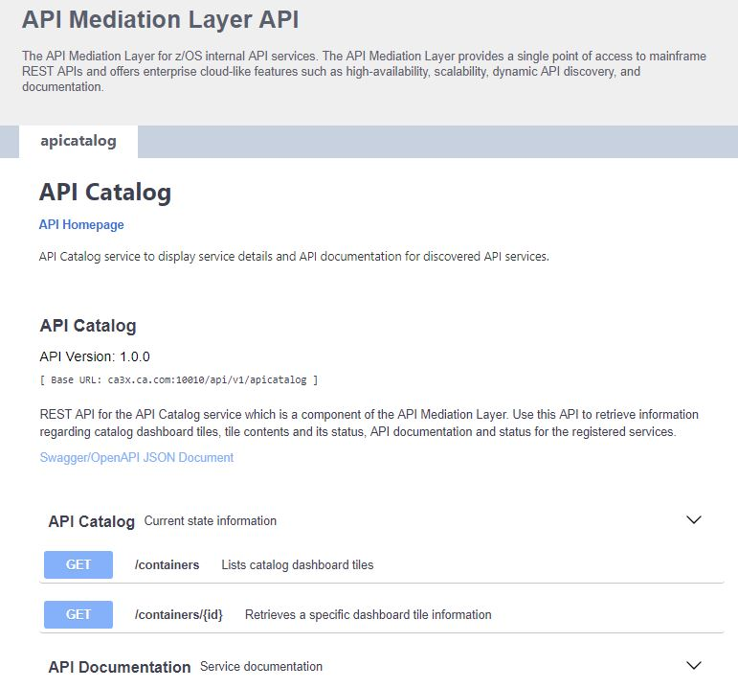
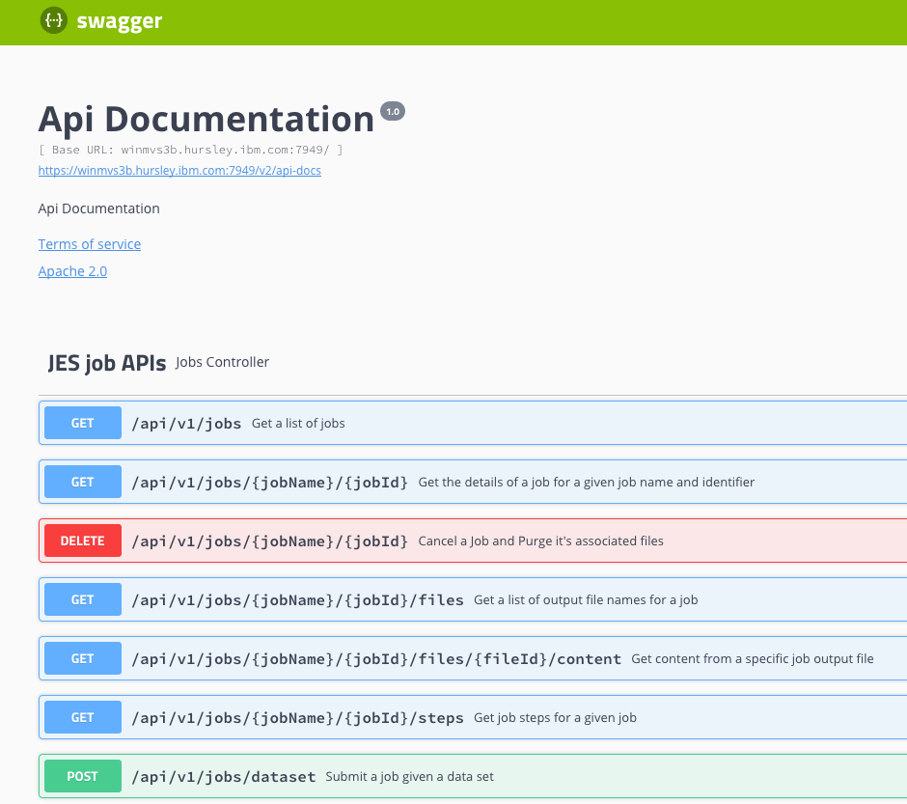
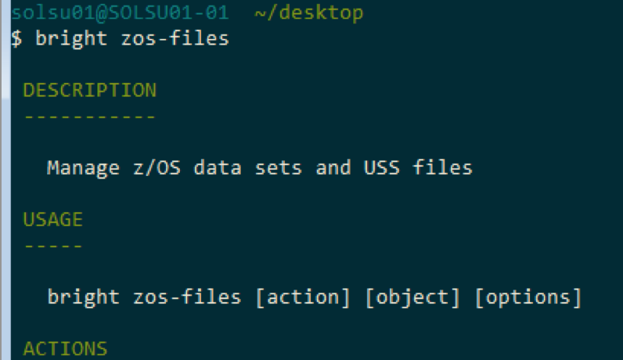
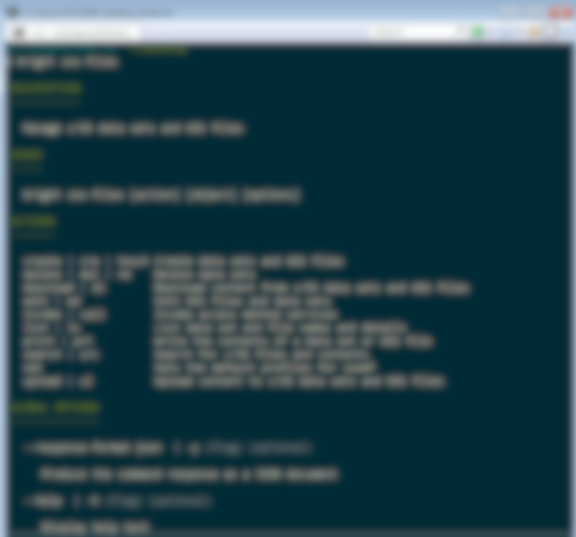
What’s in Zowe?
API Mediation Layer
(Gateway, Discovery Service, Catalog)
Browser-based Web Desktop
Swagger-defined z/OS REST APIs
Node.js- based CLI

Slide 8

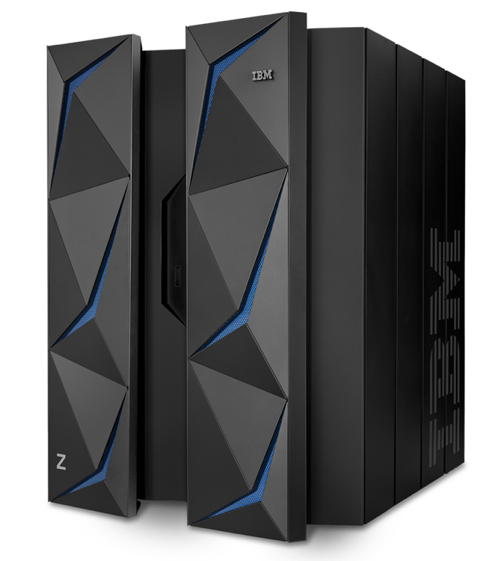
REST Services – API economy for deep integration
Industry standard REST interfaces to z/OS resources that are language and platform neutral, stateless and scalable
Foundational building blocks for system services
Zowe REST APIs
Dataset APIs
Create, read, update, delete, and list data sets
JES APIs
View the information and files of jobs, and submit and cancel job
USS APIs
Create, read, update, and delete USS files
System APIs
View information about PARMLIB, SYSPLEX, and USER
Zowe Common
Services & APIs
Vendor
Services & APIs
Client-provided Services & APIs
z/OS Management Facility REST APIs
https://ibm.biz/BdYXHX
Notes:
z/OS MF REST API Services
Application Linking Manager interface
Application server routing
Clipboard (saving data to be passed from App to App)
Cloud Provisioning (CICS, IMS, WAS, …)
Console Services
Data persistence
Data Set and file REST interface
Development Services
Information retrieval
Job Management
Multisystem routing
Notification (e-mail, SMS, …)
Software management
System Variable Services
Topology services
TSO/E address space
WLM Resource Pooling
Workflow

Slide 9
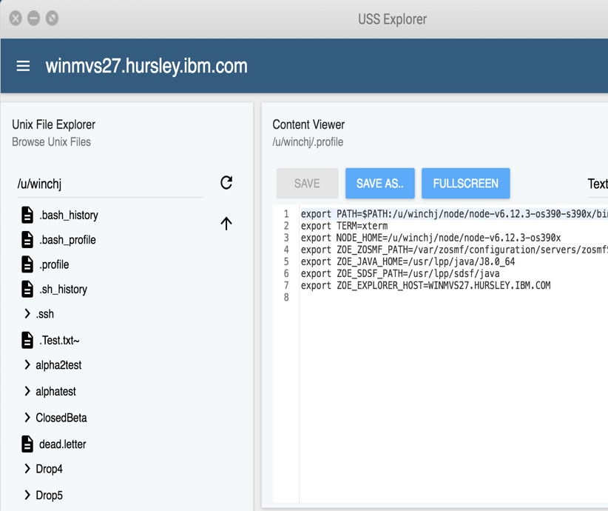
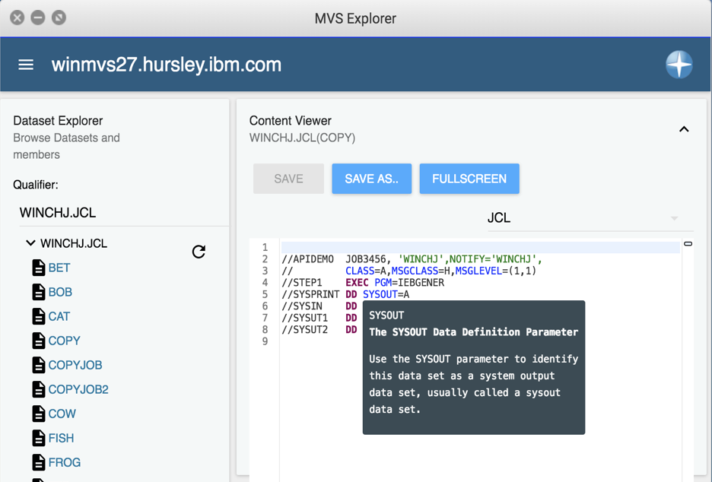
Web Desktop – An app container in a browser
Known as zLUX, the Zowe Web UI is a virtual desktop system that offers a rich and open platform for a web-based mainframe user experience.
Mainframe Virtual Desktop
A web-based window manager that provides full screen interactive experience
Zowe Node Server
Runs zLUX; uses Express.js as web service framework for communication between applications and z/OS services and components, pre-reqs Node.js for z/OS
ZSS Server
Provides secured REST API services
Application plug-in
Dataservices, Configuration dataservice, URI broker, app-to-app communication, Error reporting UI, Logging utility
Explorers
JES, MVS, USS explorers
Basic editing support for REXX and JCL
Notes:
JES Explorer
Browse jobs by filter.
User, name, status, type, return / abend code
Expand job to show file and step names
View job files to show content
Actions: Cancel, Purge, Hold, Release
If job is active file contents auto refresh
View system log
MVS Explorer
Browse MVS files status using mask
Allocate and Allocate Like PDS
Create PDS Member
Delete PDS
Delete Member
Migrate Data Set
Recall Data Set
Submit as Job PDS member and sequential data sets
View Data Set Member or sequential data set content
Edit PDS Member or sequential PDS file content: Render content for JCL and REXX
USS Explorer
Browse USS Folders and Files in navigator with filter
Create Folders and Files
Delete Folders and Files
View file content
Edit file content: Render content for javascript
Compare two files
Unix shell

Slide 10
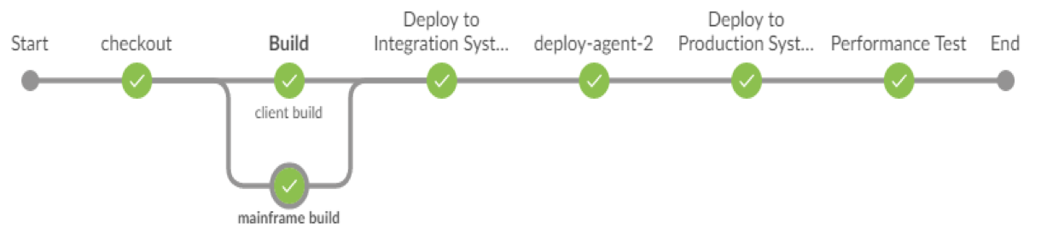
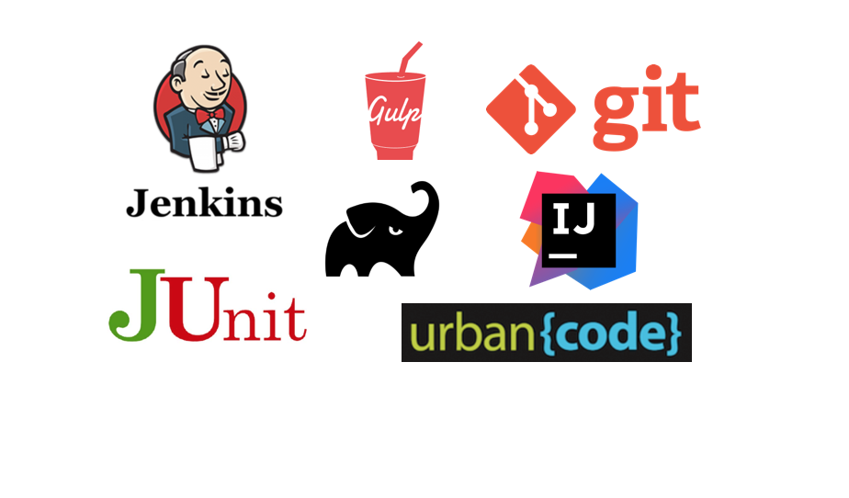
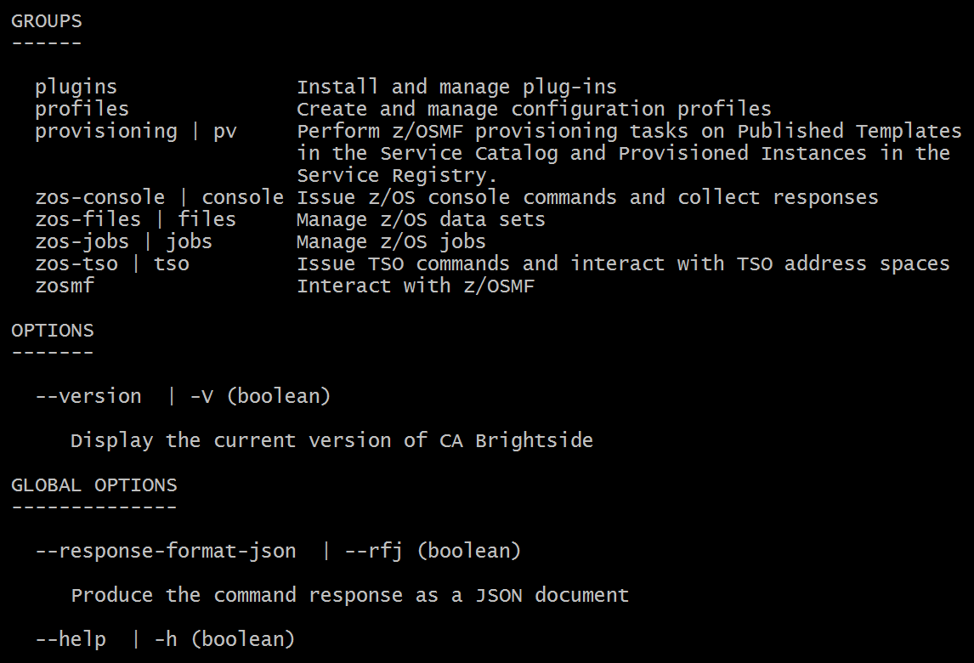
CLI – Enables cloud-like access to mainframe
Enables app developer and DevOps engineers to interact with the mainframe easily through a CLI from any terminal on Windows, MacOS, Linux
Easily integrates with IDEs, shell commands, bash scripts, and build tools; installs using NPM
Build | Test | Deploy
Interact with mainframe files Create, edit, download, and upload mainframe files (data sets) directly
Submit jobs Submit JCL from data sets or local storage, monitor status, view and download output automatically
Issue TSO and z/OS console commands Issue TSO and console commands to the mainframe directly
Integrate z/OS actions into scripts Build local scripts that accomplish both mainframe and local tasks
Produce responses as JSON documents Return data in JSON format on request for consumption in other programming languages
CLI Plug-Ins Access to CICS and DB2

Slide 11
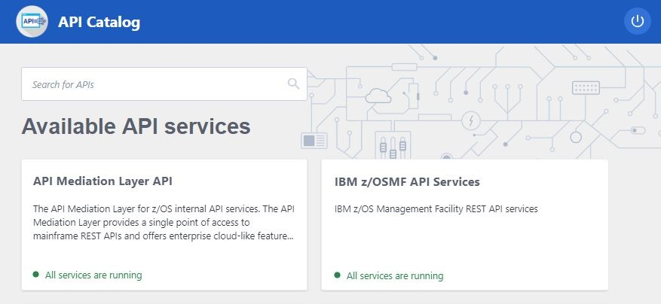
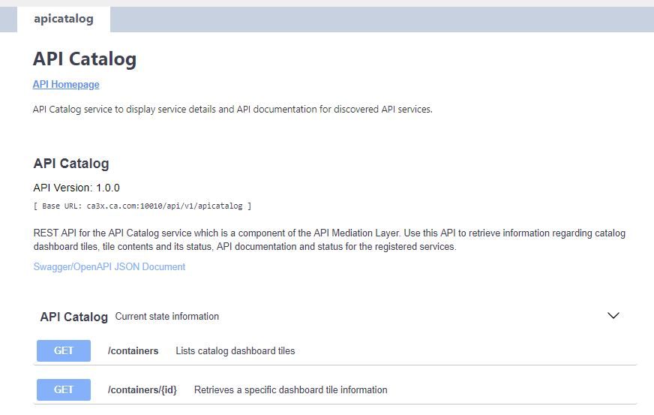
API Mediation Layer – Gateway to mainframe APIs
Enables a single point of access to mainframe APIs with high-availability, scalability, dynamic API discovery, consistent security, “one-time” sign-on experience and unified standard API documentation (OpenAPI / Swagger)
API Catalog UI Catalog of available APIs with their Swagger doc and service status
Gateway Single secure point of entry to an ecosystem of API services. Hides complexity. Highly available. Based on Netflix Zuul.
Discovery Service Discover APIs across many applications. Repository of active API services. Based on Netflix Eureka.

Slide 12
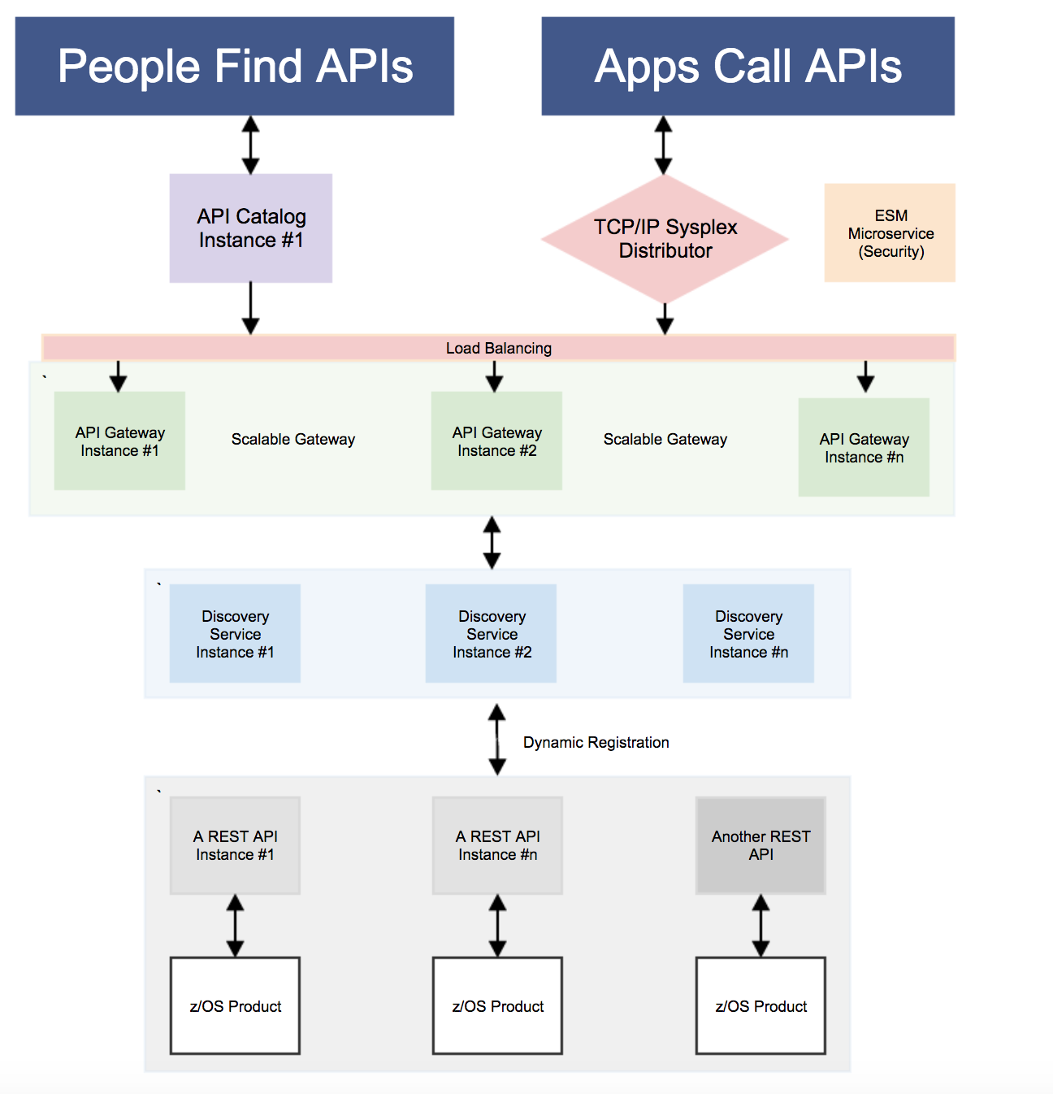
My Flow Diagram from Giza
API Layer Components*
API Catalog UI Catalog of available APIs with their Swagger doc and service status
API Gateway Single point of entry to an ecosystem of microservices. Hides complexity. Highly available. Based on Netflix Zuul.
Discovery Service Discover APIs across many applications. Repository of active services. Based on Netflix Eureka.
z/OSMF API Authenticate Zowe users with mainframe credentials
* Separate microservices, might be running as separate address spaces
z/OS Connect
z/OSMF
Jax-RS App
12

Slide 13
Zowe High Level Architecture
Base Components
Editor support (REXX/JCL to start)
CLI
APIs
Virtual Desktop – App Container
VS Code Extension
Browser/
Desktop
Web UI
CLI UI
VSC Ext.
REST API
Web-Based DevOps Services
From IBM, Vendors, Community
RESTful Services
Catalog of RESTful API
Sample Vendor / Open Source Integration
ServiceNow
JIRA
Jenkins
Git
SonarLint
z/OS
Web UI, CLI/Node.js
Common Services
Existing and New Vendor Services
Client-Provided Services
z/OSMF/Tomcat

Slide 14
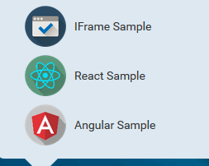
Where is Zowe Extensible?
z/OS Native Web UI for applications
Launch in context (i.e., right mouse click 3270 to web app)
App to app communication
Exploit graphic widgets planned for inclusion
Browser-based Web Desktop
14

Slide 15
Where is Zowe Extensible?
Opt in to API Mediation
Participate in Single Sign On, High Availability and Status tracking capabilities
REST API enable your products
REST API for product controls/admin
Sharing of information
API Mediation Layer
(API Catalog, Discovery Service, Gateway)
Swagger-defined z/OS REST APIs
15

Slide 16
Where is Zowe Extensible?
Node.js- based CLI
z/OSMF
REST APIs
TSO, Console
JES, MVS. USS
Out of box commands
zos-files DS
zos-files US
zos-jobs
TSO
Console
“plug-ins”
Your application, product, tool, …
Custom
Extensions
16

Slide 17
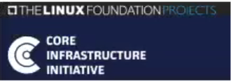
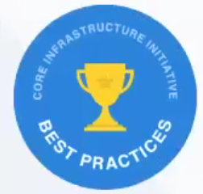
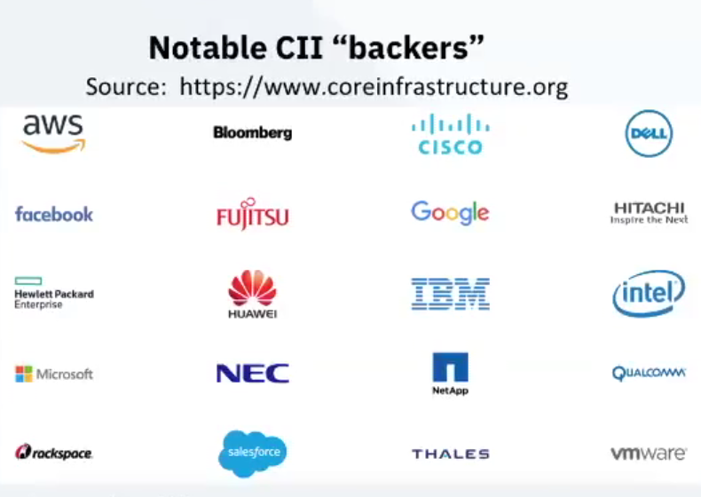
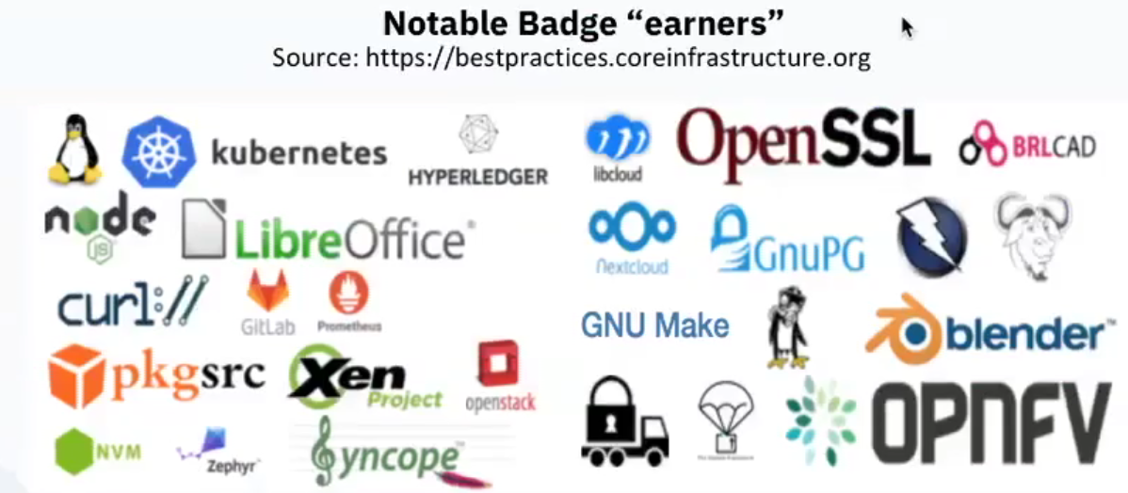
Commitment to Core Infrastructure Initiative (CII) & Badge Program
“CII is a collaborative, pre-emptive program and approach for strengthening cyber security that is widely supported by industry leaders”
“CII Badge Program is a self-certify, declaration of industry best practices and conformances in driving secure software development and governance”

Slide 18
The Zowe open community
Check out https://zowe.org/about-us/
Zowe Leadership Committee (ZLC)
Zowe Continuous Integration/Continuous Development (CI/CD)
A foundational principle of this new project is meritocracy. The more that somebody contributes, the more responsibility they will earn. A pattern of quality contribution to a project may lead to an invitation to join the project as a committer.
Leadership roles in the Project are also merit-based and earned by peer acclaim. Merit must be demonstrated in publicly-accessible forums. Committers and project leads are added to a project via an election.
Zowe On-boarding
Zowe Core Technology
Zowe API Mediation and Security
Mission: Develop the material and supporting activities for onboarding developers and customers
Mission: expand upon the base technologies being contributed to the project
Mission: expand upon integration and interface extension points and overall security
Open Mainframe Project Board
Open Mainframe Technical Steering Committee
Open Mainframe Marketing Committee

Slide 19

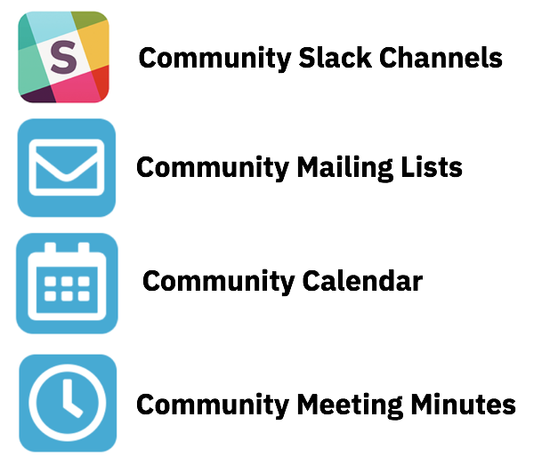
Getting Started with …
Project Community site
https://zowe.org
Access to Beta Download
https://zowe.org/download
Review Zowe squads, missions and activities
https://zowe.org/contribute/
Code Guidelines
https://zowe.org/code-guidelines/
Project Governance
https://zowe.org/about-us/
GitHub
https://github.com/zowe
Project Documentation (includes user and install guides)
https://zowe.github.io/docs-site/
Developer Tutorials
https://zowe.github.io/docs-site/guides/intro.html
https://developer.ibm.com/tutorials/zowe-step-by-step-tutorial/

Slide 20
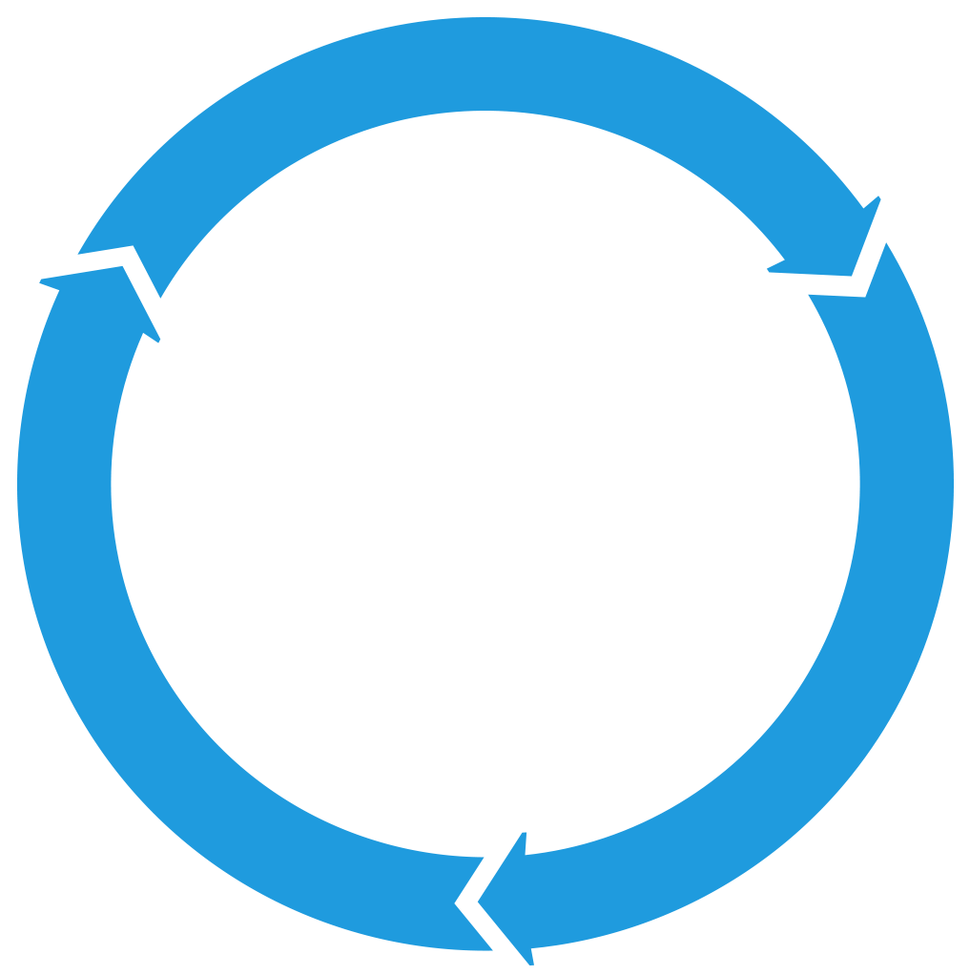


Get involved in the Zowe community
Join Open Source Community @ https://www.openmainframeproject.org/projects/zowe
PROJECTS
Participate in and contribute to the Zowe developer community at zowe.org
Learn how your organization can become a steward and supporter of this project with Open Mainframe Project membership at openmainframeproject.org/about/join
DEVELOPER
COMMUNITY
PLATFORM
PARTICIPATION
Ecosystem
PROFITS
PRODUCTS
PROMOTION
SOFTWARE

Slide 21
“Demo”
Intro Demo:
https://www.youtube.com/watch?v=NX20ZMRoTtk&feature=share
Visual Studio Code (using command line):
https://www.youtube.com/watch?v=la1_Ss27fn8

